Slide 1
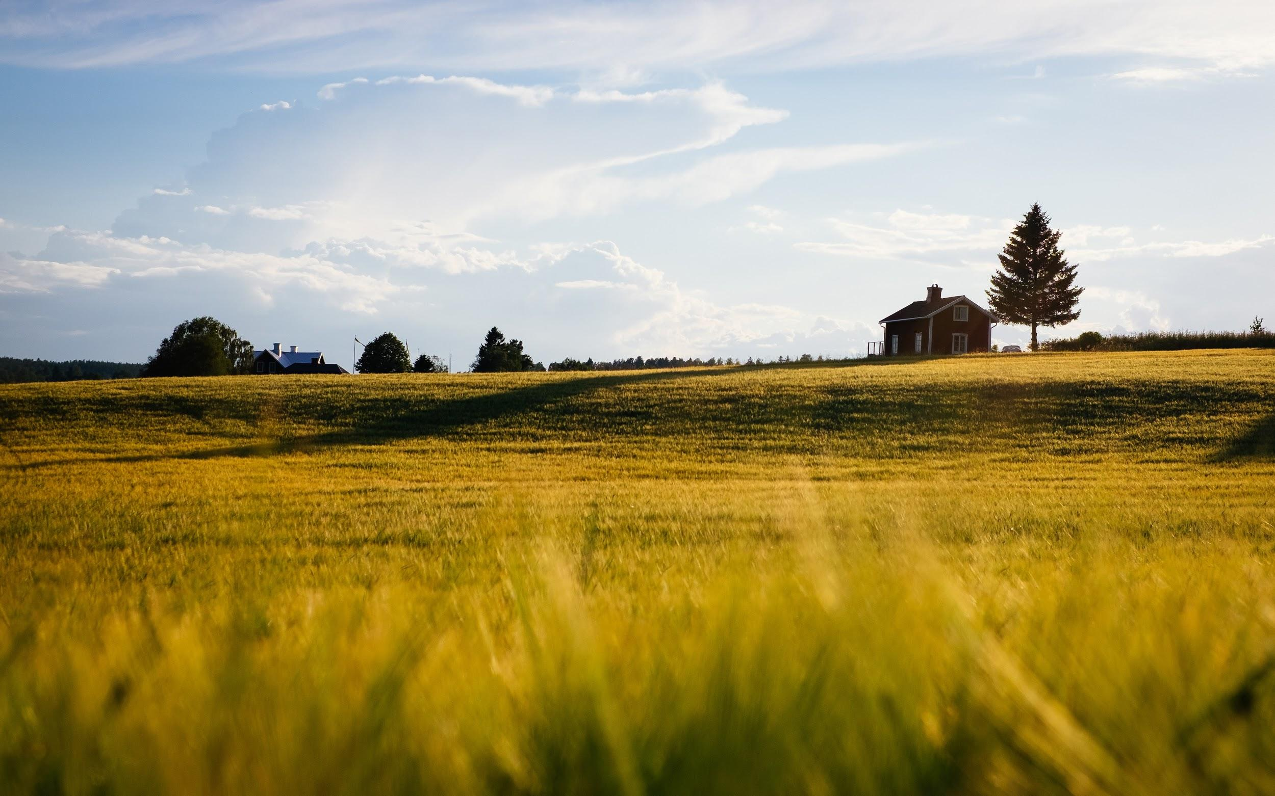
Farmer’s Market Hub
Team: V6
Mentor: Eberto Ruiz

Slide 2
Contents
- Solution Overview -
1
Problem Statement
5
Technology Stack
- Market Potential -
2
The Customer
6
Why Visa?
3
The Merchant
7
Business Potential
- Technology -
- Demonstration -
4
VISA APIs
8
Implementation & Demo
| Solution Overview | Farmers Market Hub | Intern Experience 2020

Slide 3





Problem Statement
Farmers have little to no online presence
COVID-19 cripples restaurants and food services industry
Farmers are left with excess produce
VISA steps in to support small businesses with online marketplace
VISA replaces B2B transactions that were paid with checks with VISA B2C credit payments
| Solution Overview | Farmers Market Hub | Intern Experience 2020

Slide 4
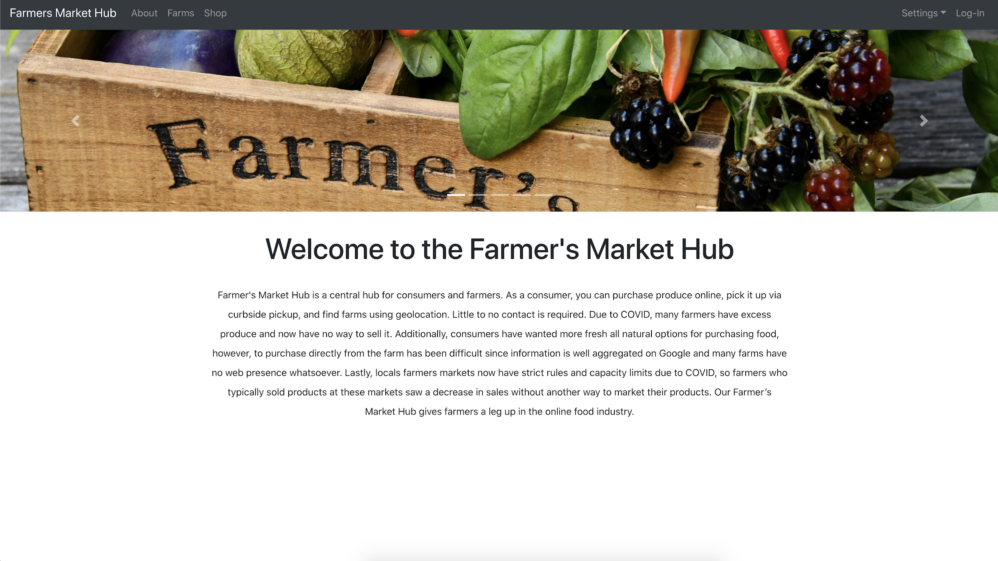
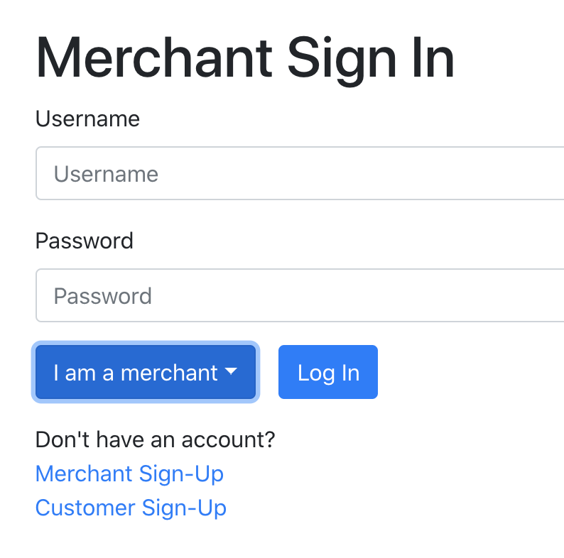
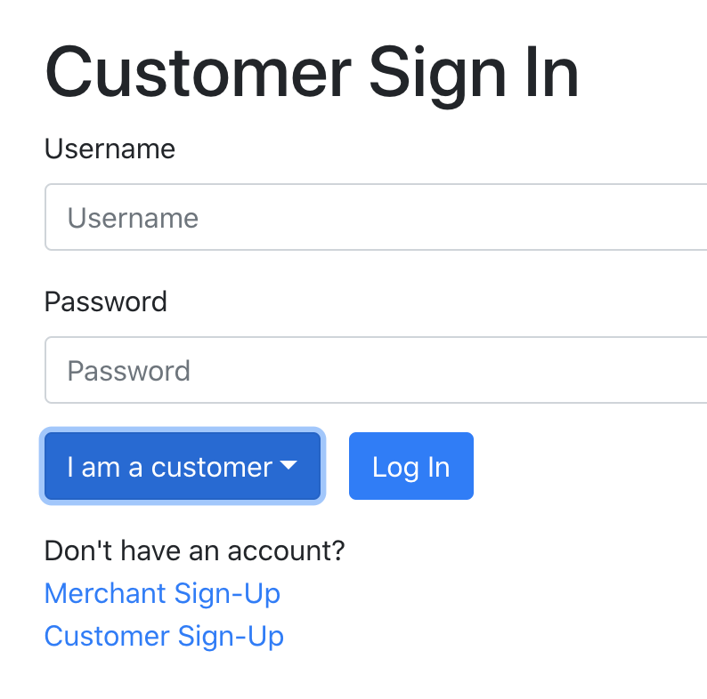
A Site for Merchants and Customers
| Solution Overview | Farmers Market Hub | Intern Experience 2020

Slide 5
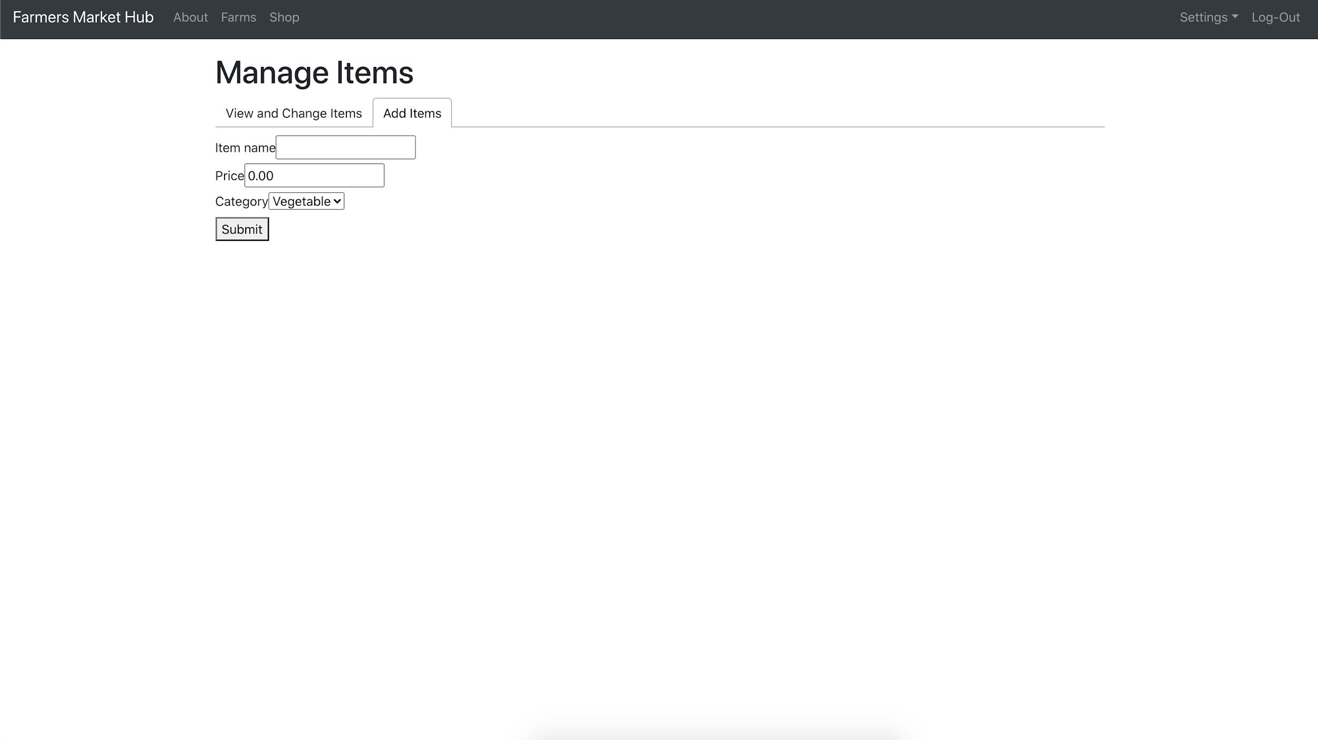
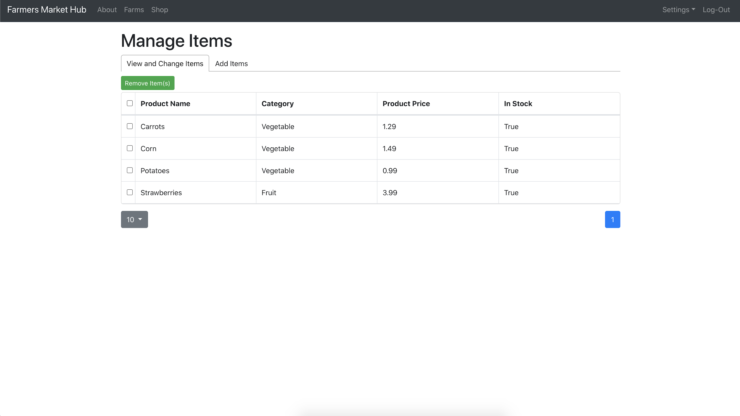
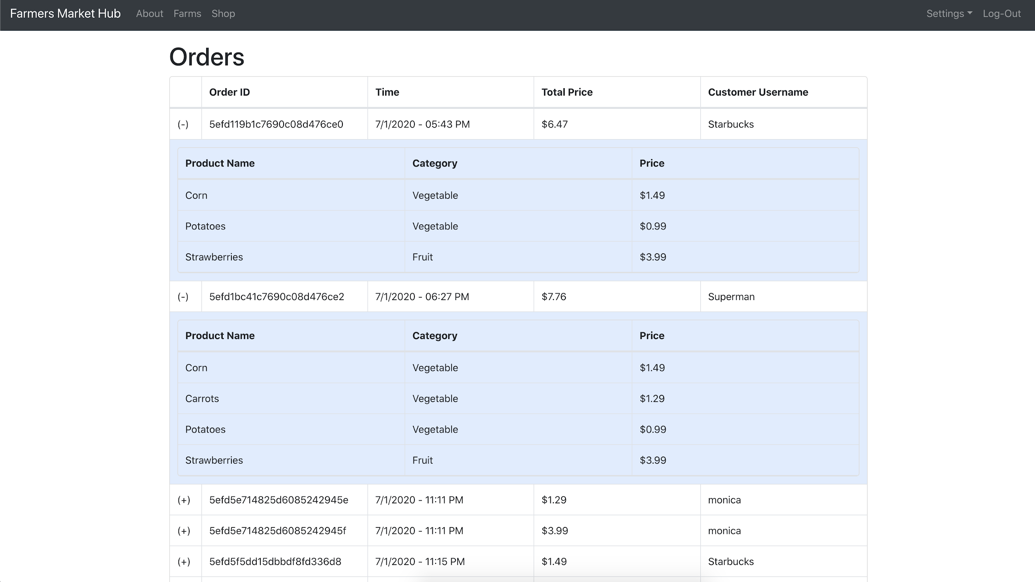
Merchants
Payment processing with Visa Checkout
Faster receipt of payments
Credit card payments alleviate customer non-payment risk
Easily add, remove, and edit products to sell
Customer order management
Access to a broader customer base
| Solution Overview | Farmers Market Hub | Intern Experience 2020
Notes:
Faster receipt of payments (invoicing typically net 30 and could be even longer now since their customer base restaurants are financially struggling)
Guaranteed payment - a large % of their customer base is currently struggling and potentially looking at bankruptcy
Broader customer base
Easy setup and item management
Easy payment processing with VISA checkout

Slide 6
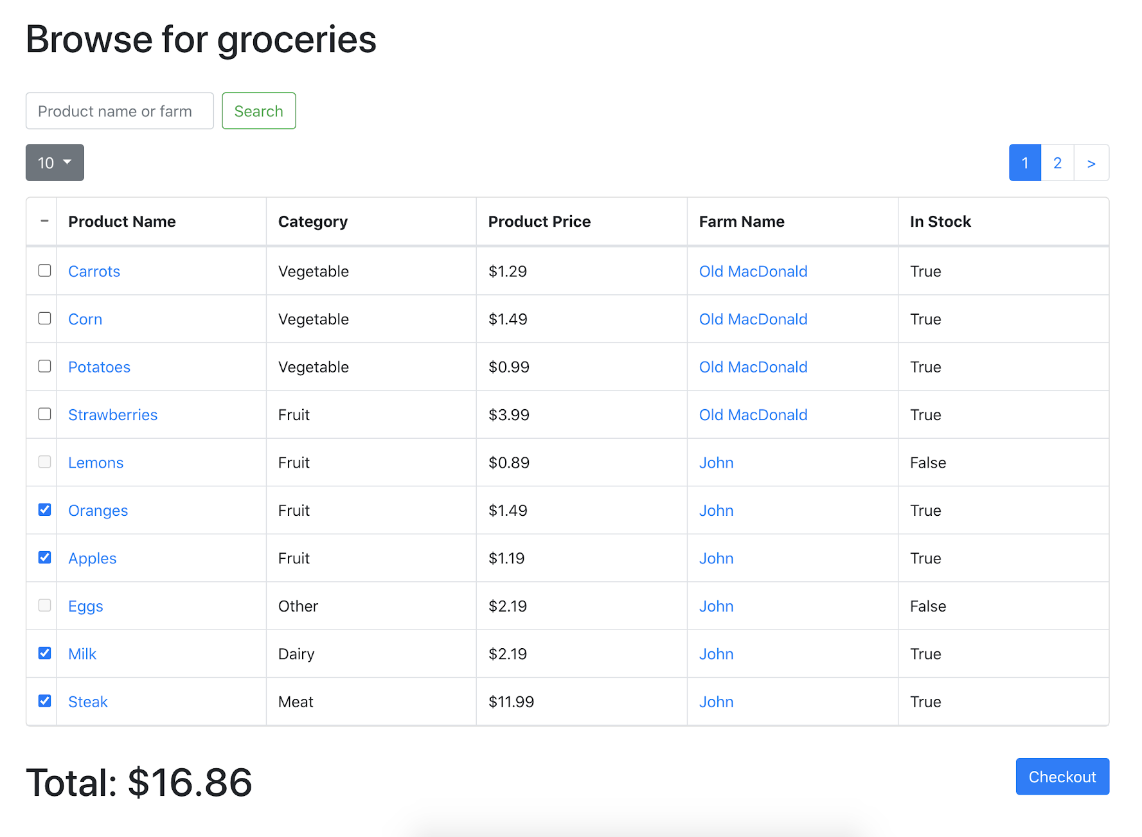
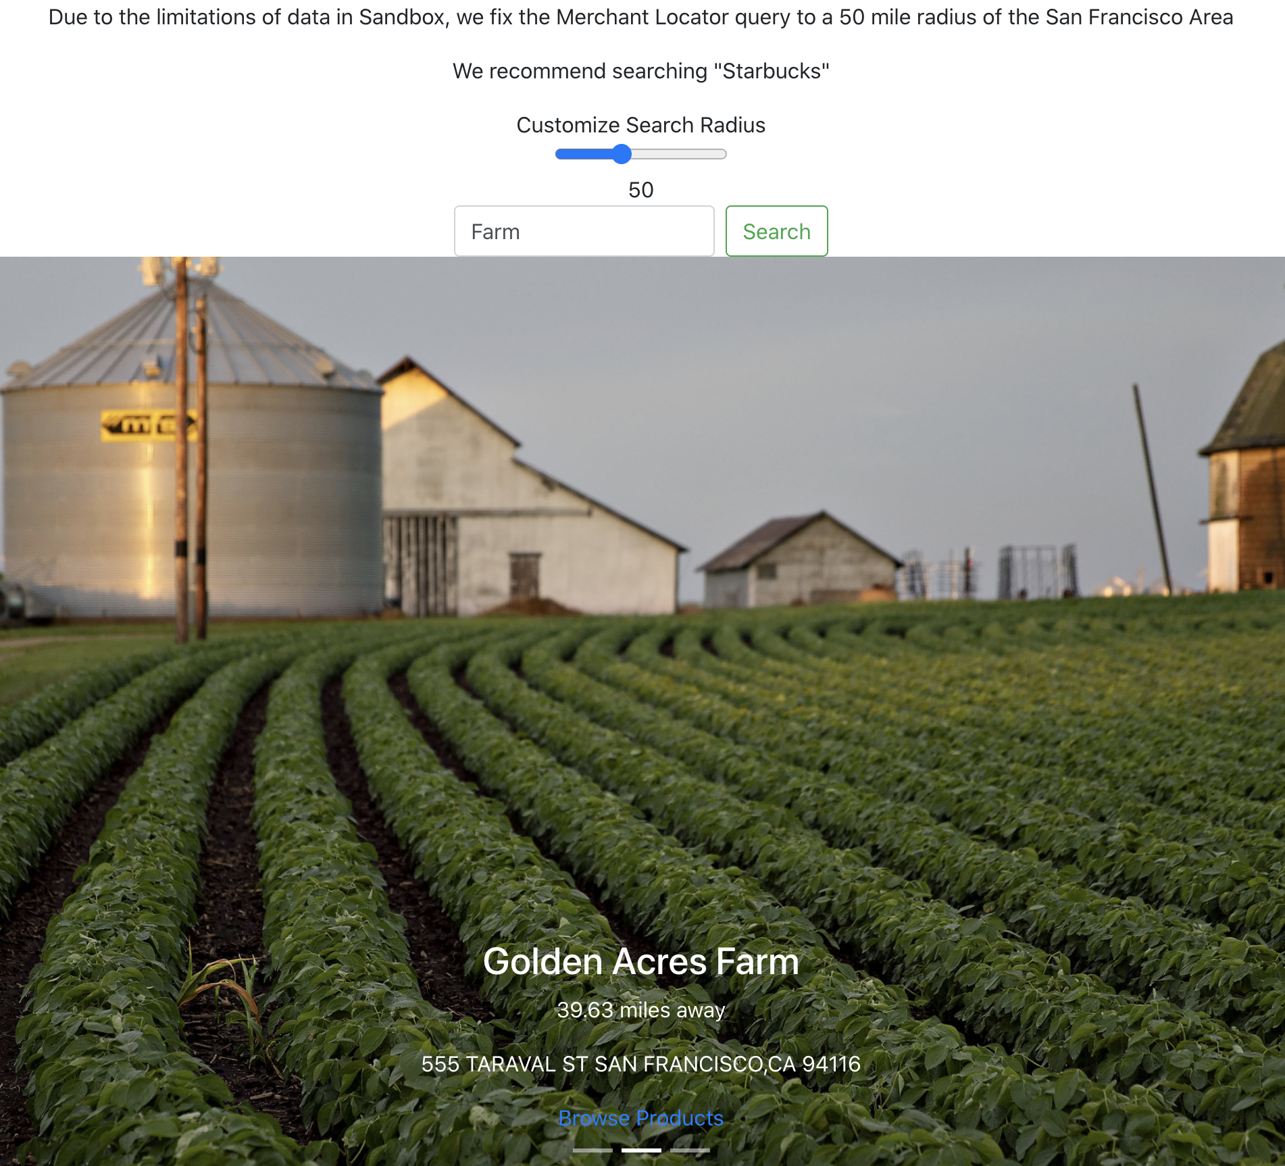
Customers
Easily shop for fresh produce and place order
Geolocation to find nearby farms
Quick and cashless transaction so order is ready upon arrival (pick-up groceries)
Merchant locator:
| Solution Overview | Farmers Market Hub | Intern Experience 2020

Slide 7


APIs
Visa Checkout
Merchant Locator
Why?
Secure
Open
Simple
Community
Why?
Issuer/Cardholder
Independent Developer
| Technology | Farmers Market Hub | Intern Experience 2020
Notes:
Direct from Website
Secure-Visa Checkout uses multiple layers of security, including fraud monitoring systems and encrypted tokens using SHA256 hash algorithms, to help keep payment information safe.
Open-Visa Checkout accepts most major credit or debit cards so customers can checkout easily and securely using the payment method they use today on your site.
Simple-Integrating Visa Checkout is easy and requires only a few simple HTML and JavaScript tags. Quickly and easily test your setup in our sandbox environment.
Community-Join a growing community of commerce developers and get the support you need.
Issuer-Your cardholders want to know where they can shop and get special rewards. Use the Merchant Locator API to find those merchants real time based on the cardholder location information and your rewards rules.
Independent Developers-Want to build a new app that will show cardholders where they can find local stores in just the category they need? Use the Merchant Locator API to find those merchants real time based on the cardholder location information and preferences you know about them.

Slide 8

Technology Stack
The Benefits
Timeframe - Rapid design, implement-ation, and QA
React Native - Simple Mobile Dev
SPA - Optimized and Seamless UI
Javascript - Single Language
| Technology | Farmers Market Hub | Intern Experience 2020

Slide 9
Strategy - Why Visa?
Insight: With Farmer’s Market Hub, VisaNet will support the economic empowerment of struggling farmers and curtail COVID-19 concerns.
35%
30%
$3.0 Billion
Direct-to-Consumer Market
In-Person Cash Transactions
MoM Growth in U.S. food retail sales
Safety Concerns
Potential for Electronic Payments
Cashless
Contactless
E-commerce
Consumer demand for fresh food
Support Farmers
Food Security
1. United States Department of Agriculture National Agricultural Statistics Service 2016
2. Federal Reserve Bank of San Francisco 2019
3. United States Census Bureau March 2020
| Market Potential | Farmers Market Hub | Intern Experience 2020

Slide 10
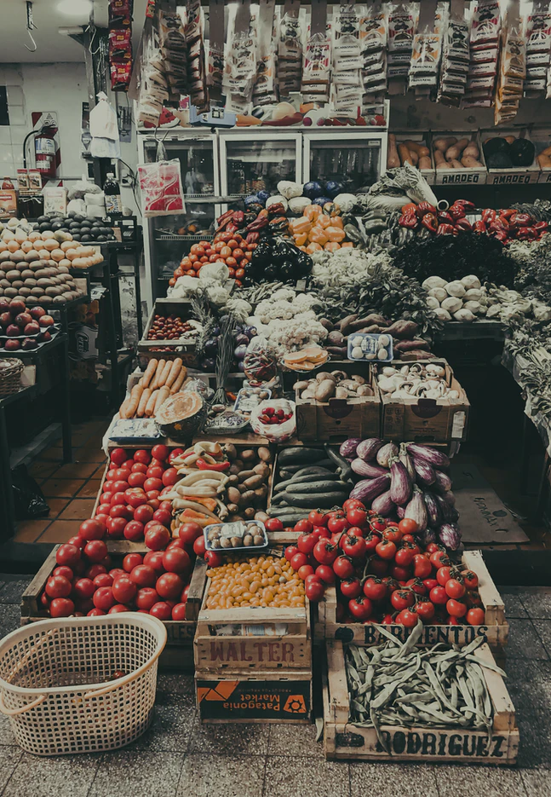
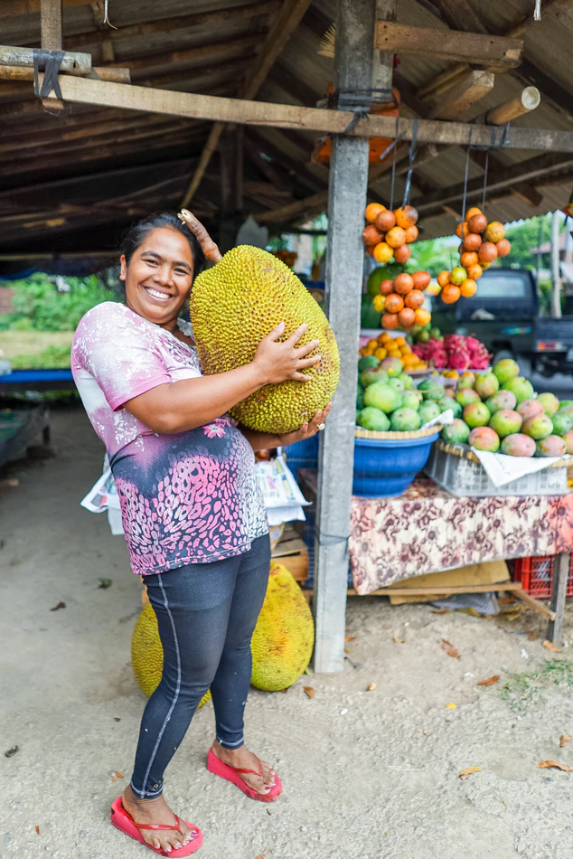
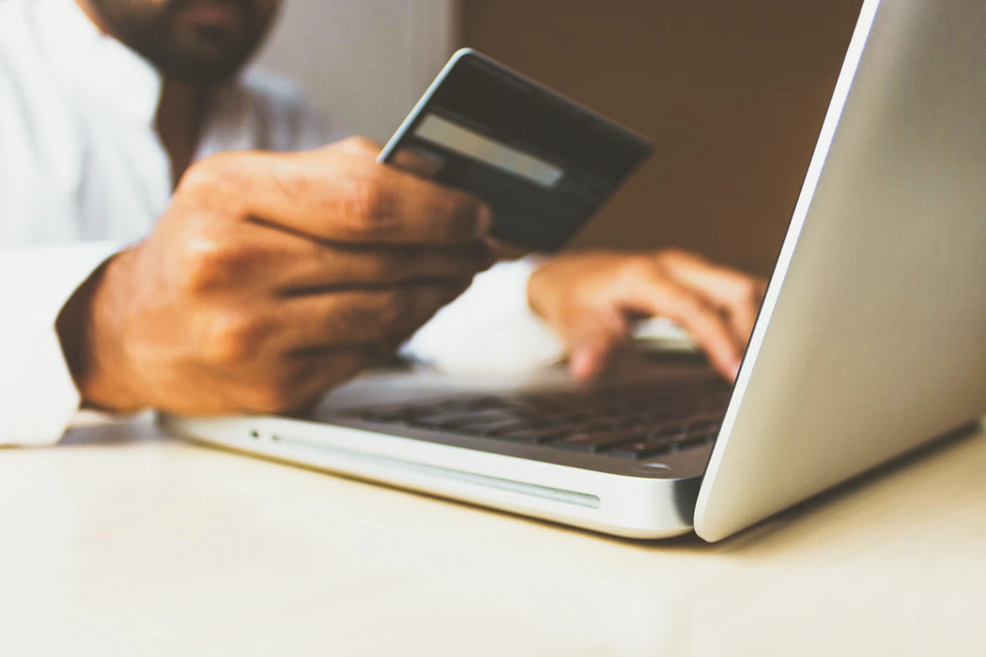
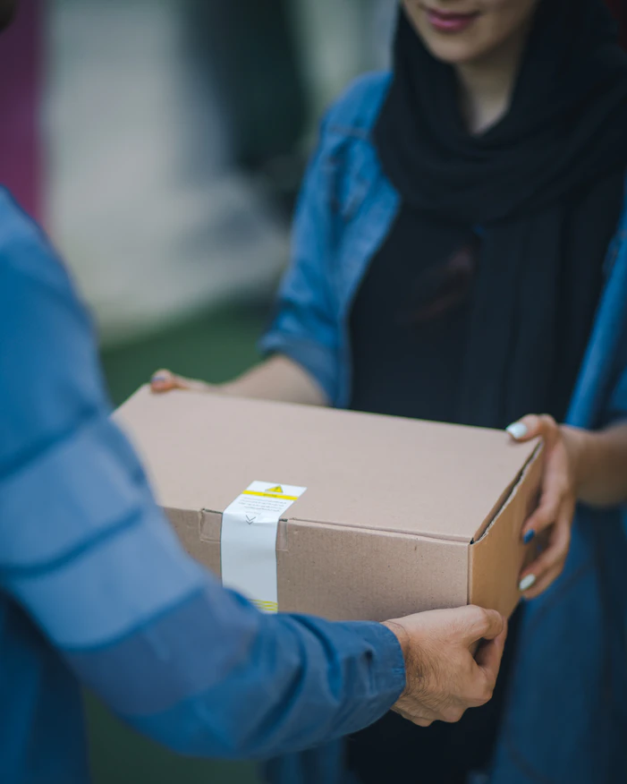


Strategy - Business Potential
| Market Potential | Farmers Market Hub | Intern Experience 2020

Slide 11
Demonstration
The Solution
| Demonstration | Farmers Market Hub | Intern Experience 2020

